Slide 1
CubeSat Constellations: Addressing Multi-Orbit Communication Challenges
Stephen Ennis – MAI Computer Engineering 16/17
Supervised By: Dr. Johnathan Dukes

Slide 2
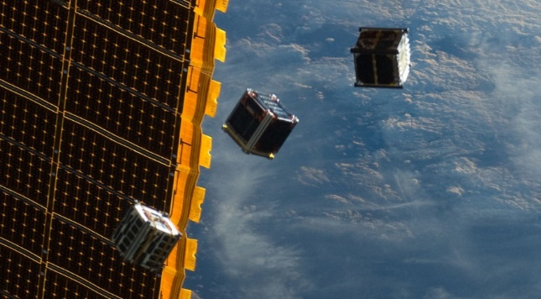
CubeSats
One unit is 10 cm cube
Multiple units combined up to 6 units
Extensive use of commercial of the shelf hardware
Typically max communication power of 2 watts
Typical one unit batteries supply 25 to 50 watt hours
Currently about $75,000 for construction and launch
Low earth orbit 160-2000km (~500km)

Slide 3
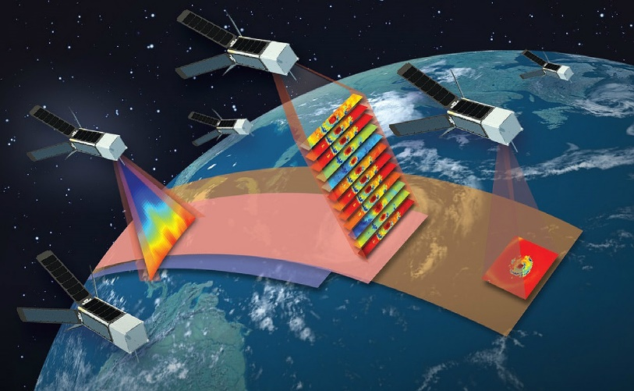
Constellations
Satellites deployed in some formation
CubeSat constellation coming soon qb50
In our case we will consider multi-orbit constellations
Individual CubeSat orbits constantly changing
Basic CubeSat formation flying has been demonstrated
For now, CubeSat constellations communicate via omni-directional antennae as CubeSat attitude control develops

Slide 4



Missions
NASA’s EDSN … blew up
NASA’s Nodes used EDSN two leftovers
CNSA’s Tianwang-1 (TW) is by far the most successful networked CubeSat mission thus far
TW showed basic formation flying and implemented a new SDR based inter-satellite link (ISL) approach
Several missions on the horizon: QB50, Tropics, CPOD, GomX-4, AIM COPINS and so on

Slide 5
Propagation challenge
Unless the constellation is very large or restrained to particular orbits ground station will only be ‘in-view’ for short periods
How can command and control data be assured to reach the required CubeSats?
CubeSats will experience in-orbit and inter-orbit drift
CubeSats in an adjacent orbit may be unreachable
Available power is the key limiting factor

Slide 6
Collection challenge
The constellation must take advantage of ground station fly-overs in order to maximize data downlink
Downlink speeds often of the order of tens of kbps
Accurately modelling constellation configuration on a single CubeSat is too costly
Constellation updates will have come from ground
The constellation may be partitioned with out of date telemetry. Portions could become isolated

Slide 7
Proposed Approach
Draft a hypothetical modern CubeSat constellation mission
Payload, Orbit, Power, Comms, Lifetime, etc.
Use dynamics modelling software to model a sample constellation based on successful missions
Analyze dynamics model to extract communications windows and ranges
Use assumptions and analysis to inform a network simulation

Slide 8

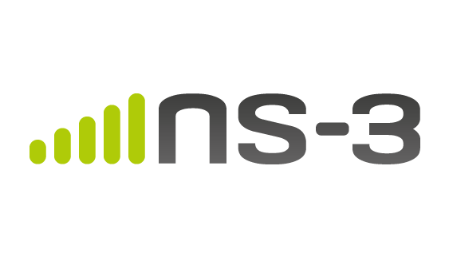
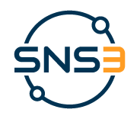
STK11 & SNS3
STK is powerful astro/aerospace mission design and analysis tool
STK can be used to model ground station fly-overs and inter-satellite ranges
SNS3 is an extension of the well supported network simulator 3
SNS3 was developed through ESA and greatly improves the dynamics modelling capabilities of ns-3 for Satellite missions

Slide 9
Expected results
The network simulation will be tested against a number of approaches to collection and propagation challenges
The research intends to shed light on potential best approaches which maximize certain properties such as:
Average CubeSat power availability
Data propagation rates
Payload data downlink throughput

Slide 10
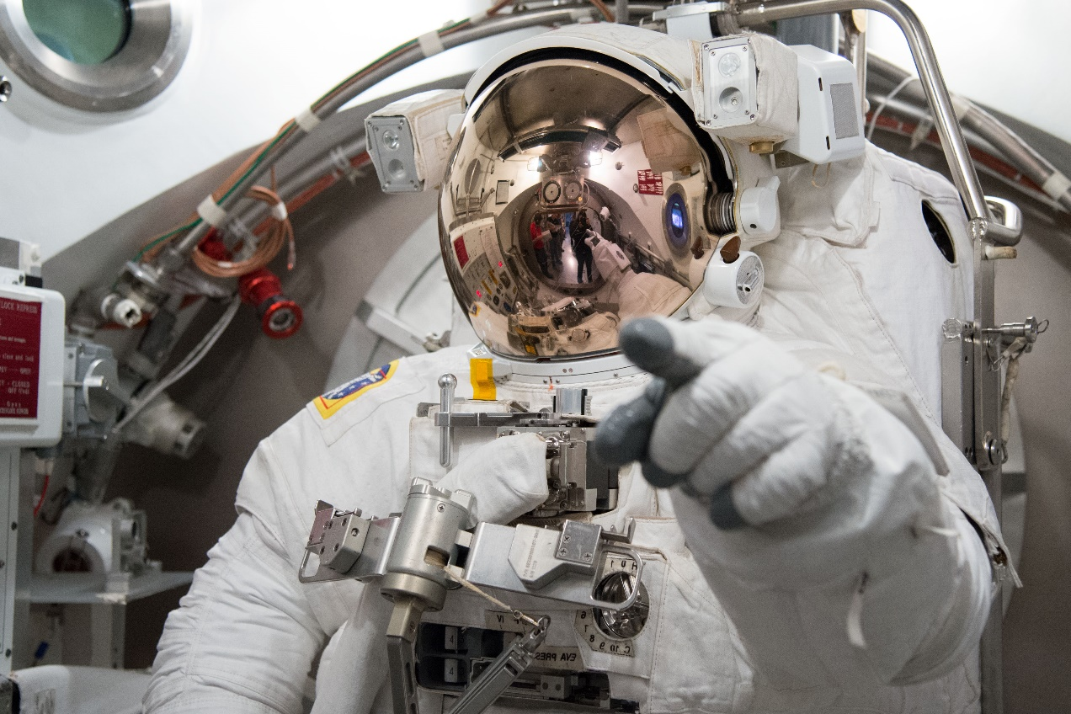
Questions

